Slide 1
Kashish sharma
Nepal Msisdn

Slide 2
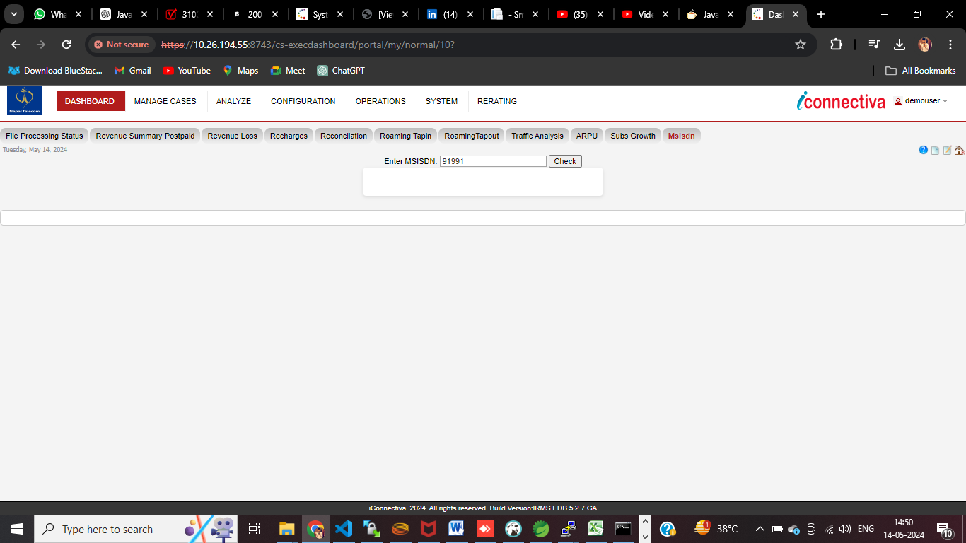
First we insert the number of Msisdn and click on check

Slide 3
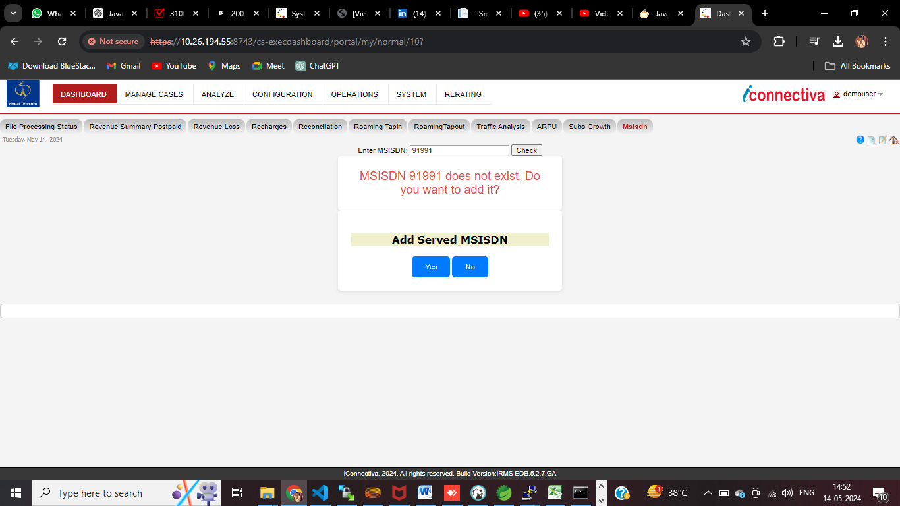
Then it checks whether the MSISDN number exists or not . If it doesn’t exists then I shows the add option to user to add the number . Then if you click on add it adds the number or if you click no it doesn’t .

Slide 4
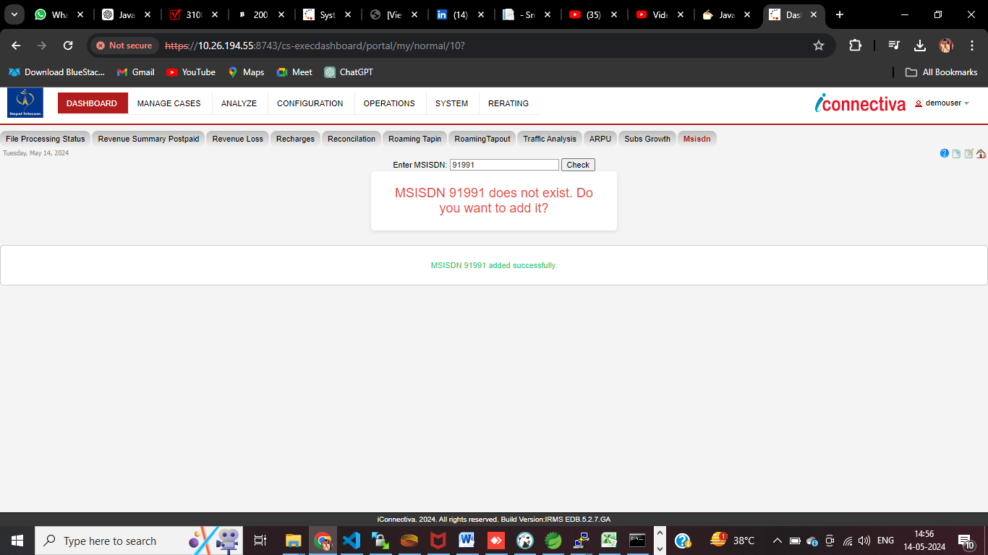
If click on add then the MSISDN number get added and we get a message in UI if its added.

Slide 5
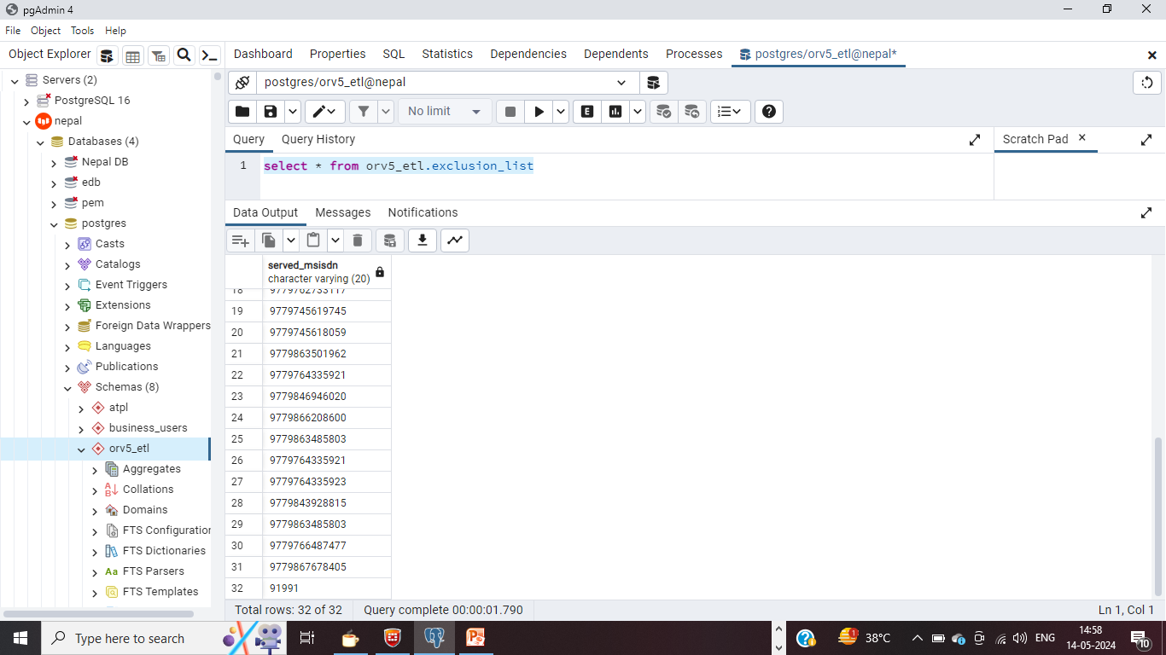
As you can check 91991 Msisdn number is added , Now if we again go to our UI

Slide 6
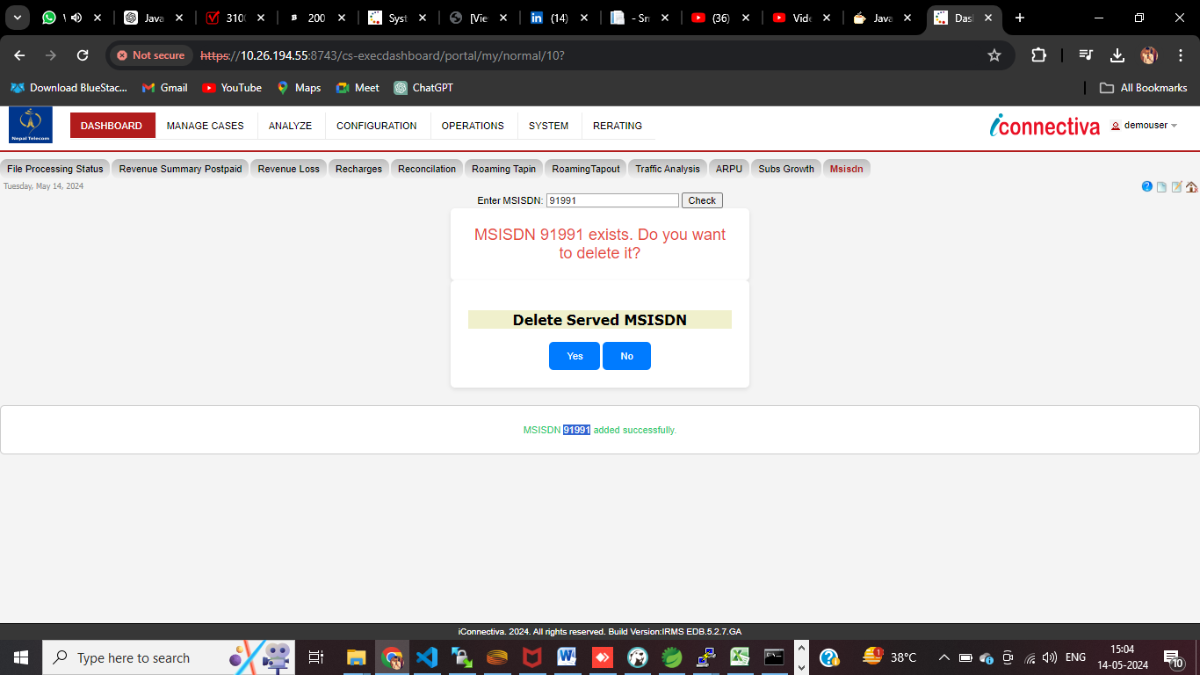
IF we click on again check ? If Msisdn Number Exists it shows the option to delete It

Slide 7

If User click on yes then Msisdn number will get deleted and a popup will show up if successfull .And MSISDN number will be removed

